Slide 1
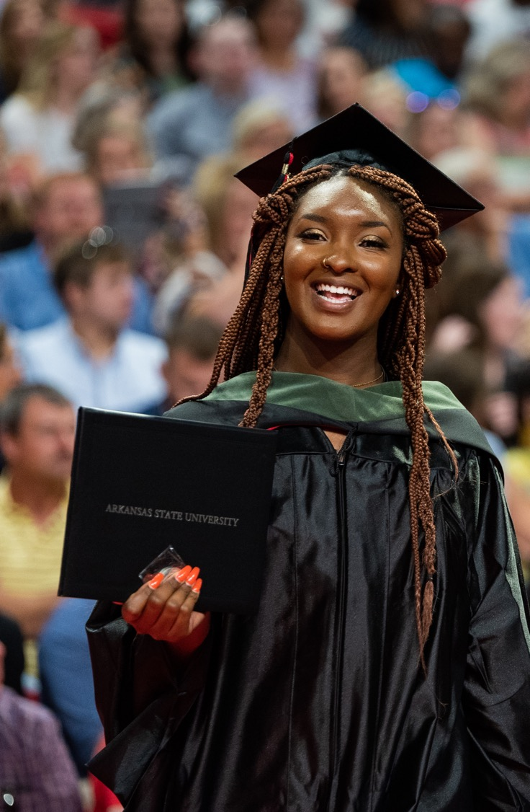

Getting Started:
Classroom Policies and Resources for Student Success
Dr. Nikesha Nesbitt
Dean, University College nnesbitt@astate.edu
Educate Enrich Enhance

Slide 2
“Faculty, Program Directors, Department Chairs, and Deans shape departmental culture and are critical to student success.” (Strikwerda, 2019)

Slide 3
Student Success Services
Access & Accommodations Services
Career Services
Counseling Services
Learning Support Services
Health Center
Honors College
Pack Support
Student Support Services (TRiO)
Student Life
Transition Studies
University Advising Center

Slide 4
STUDENT SUPPORT STRUCTURES
PRIMARY ADVISORS
Transition Studies
University Advising Center
Department/College
Faculty Advisors (Undergraduate & Graduate level)
SUPPLEMENTAL ADVISORS
Athletics
Student Support Services
Honors
FIRST YEAR EXPERIENCE

Slide 5

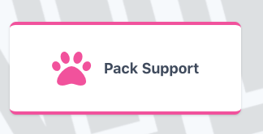
PACK SUPPORT REFERRAL SYSTEMS packsupport@astate.edu

Slide 6
ATTENDANCE POLICY
Lower Level Courses (1000 and 2000)
Students enrolled in freshman or sophomore level courses may miss no more than twice the number of sessions that would normally be scheduled during a week (MWF = 6; MW or TR = 4; once per week = 2)
Students enrolled in 3000 and 4000 level courses will not be assigned a grade of F solely for excessive absences unless FN grading applies
Graduate Level - Attendance policy is established by the faculty of record. However, WN grade does apply to all graduate and undergraduate courses

Slide 7
UNIVERSITY SPONSORED EVENTS
Students participating in these events will not have those days counted against their available absences and will be given reasonable opportunities to make up missed assignments and exams.
Athletic, Band, Debate events, etc.,
Allow students to complete assignments early, or upon return with a reasonable date for completion
  Do not “drop lowest exam grade” for students on sponsored events when other students get to take the exam and drop their lowest exam grade
  Do not count missed class time due to a sponsored event against a student’s attendance and/or participation grade

Slide 8
MID-TERM GRADES
Required for all freshman and sophomore level students (NOTE: 3000/4000 courses may have underclassman students which will be noted on the roster)
Optional for junior, senior and graduate-level students (encouraged)
Mid-term grades serve as critical feedback
  Assign the grade that has been earned, not a “feel good” grade so that students understand where they actually stand in terms of their grade
  Give more than one graded assignment before mid-term so students can gauge their progress

Slide 9
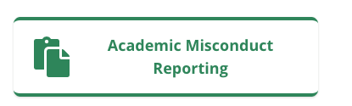
ACADEMIC MISCONDUCT
Faculty report incident via online portal in MyAState
Student meets with AAR representative to discuss their action and sanction
Student can deny responsibility and request university hearing
Faculty are informed of all actions.

Slide 10
GRADE OF INCOMPLETE - “I”
A grade of "I" is appropriate when a student is unable to meet all course requirements for reasons beyond his/her control, i.e., illness of the student, or serious illness or death in the family, or extended research projects at the graduate level
Faculty member and student must sign the Request for Incomplete Grade Form that specifies the timeline for completion, work to be completed, etc. The form is available on the Registrar’s website.

Slide 11
FINAL EXAMS
  Final exams are to be given on the date and time indicated on the final exam schedule posted on the Registrar’s website
  Late submission of grades impacts student scholarships and financial aid; ability to compete in sporting events such as bowl games; academic standing; etc.
  Graduating senior grades must be provided by the date/time specified before other grades are due (graduating seniors will be identified on your rosters at the end of the term)

Slide 12
INCLEMENT WEATHER POLICY
In extreme circumstances determined by the Chancellor, the University may close due to inclement weather situations.
Regional and local news media will publicize the closing: KAIT-TV 8, A-State Web Page; Local Radio Stations; A-State Emergency Alerts
Sign up for A-State Emergency Alerts in “MyAState”
Commuter students are encouraged to use good judgment. Please note weather conditions varies considerable. Students are responsible for missed assignments during inclement weather within a time frame to be determined by the professor

Slide 13
TEXTBOOKS & COURSE MATERIAL
Federal and state law govern specific dates for textbook orders for the fall, spring, and summer terms:
Spring semester textbooks are due October 15 & Summer and Fall semester textbooks are due March 15 to the official A-State bookstore: Textbook Brokers. Specific instructions are provided to faculty in advance of these dates
Faculty are encouraged to utilize low-to-no cost course materials. Open source, electronic and other formats are the least costly for the student

Slide 14
Set the tone
“Culture eats strategy, if not for breakfast then at least by the time of the mid-morning coffee break”-Peter Drucker

Slide 15
FACULTY ROLE IN STUDENT SUCCESS
YOU ARE NOW THE CAMPUS EXPERT
Understand the culture within your major/college
Be observant in the classroom. Get to know names and additional information
Be transparent about protocol, performance expectations, your preferred learning behaviors, and interactions
Be familiar with A-State support structures & frontload student support avenues in class material
Provide feedback. Utilize Starfish early feedback system
Help students make connections between coursework and life goals
Take “5” at beginning or end to check-in with students

Slide 16
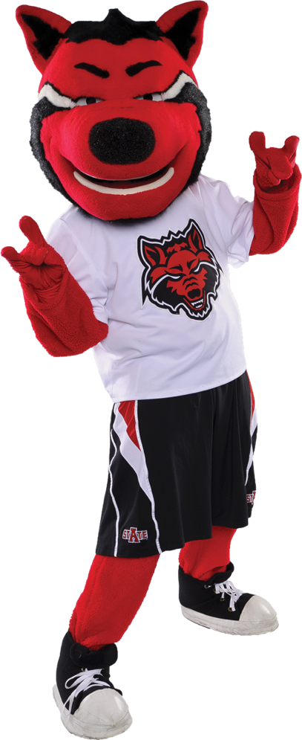
Questions
Have A Great Fall 23 Semester!!!!

